Slide 1
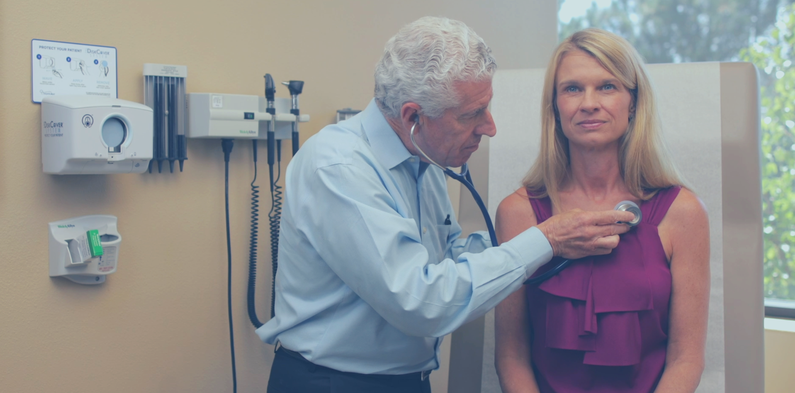

Stethoscopes Are Now Touch-Free
Stethoscopes Are Now Touch-Free
The DiskCover System
Eliminating Stethoscope Pathogen Transmission By Touch

Slide 2




| INTRODUCTION: PROBLEM
THE CLINICIAN'S THIRD HAND:
The Stethoscope
1
Contaminated stethoscopes are common and pose a significant safety risk.
Clinical Library
A multitude of clinical and scientific publications establish
the stethoscope as a vector of pathogen transmission

Slide 3


| BACKGROUND
THE CLINICIAN'S THIRD HAND:
The Stethoscope
Just like a clinician’s hands,
stethoscopes harbor dangerous contaminants and organisms.
Common methods of hygiene do not demonstrate complete efficacy, and can even contribute to additional risks of infection.
Diligent Hand Hygiene Efforts are Undermined by Weak Stethoscope Hygiene
3
2
1

Slide 4

| ALCOHOL CLEANING
Background
Alcohol Cleaning
Variable Effect,
Time-Consuming, & Low Compliance
SUBOPTIMAL STANDARDS
Alcohol Cleaning
Stethoscope cleaning is time-consuming (60-seconds), seldom performed, and ineffective against resistant pathogens. Despite cleaning, surfaces often remain contaminated.
Multiple studies also indicate that clinicians rarely clean their stethoscopes.
3
3
4

Slide 5

| SINGLE-PATIENT STETHOSCOPES
Background
SUBOPTIMAL STANDARDS
Single-Patient Stethoscopes
Meanwhile, single-patient stethoscopes have reduced sound quality and may contaminate staff and patients.
Practitioner and patient room stethoscopes are colonized with nosocomial pathogens, and cleaning reduces but does not always eliminate contamination.
Single-Patient Stethoscopes
Ineffective, Expensive, Cheaply Made, Poor Auscultation Quality
5
6

Slide 6

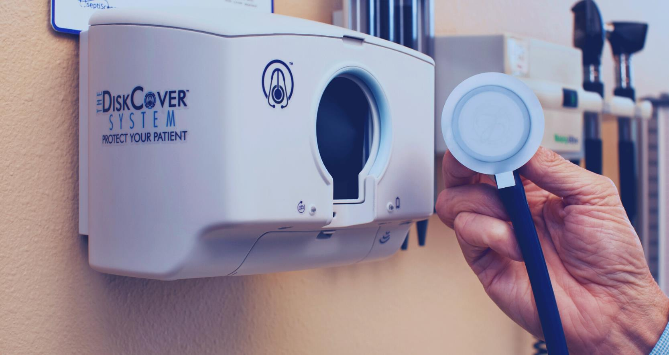
| THE DISKCOVER SYSTEM
Introduction
The DiskCover System eliminates patient risk of stethoscope “transmission by touch“ by providing a clean and high-fidelity barrier, removing direct contact between patient and stethoscope.

Slide 7
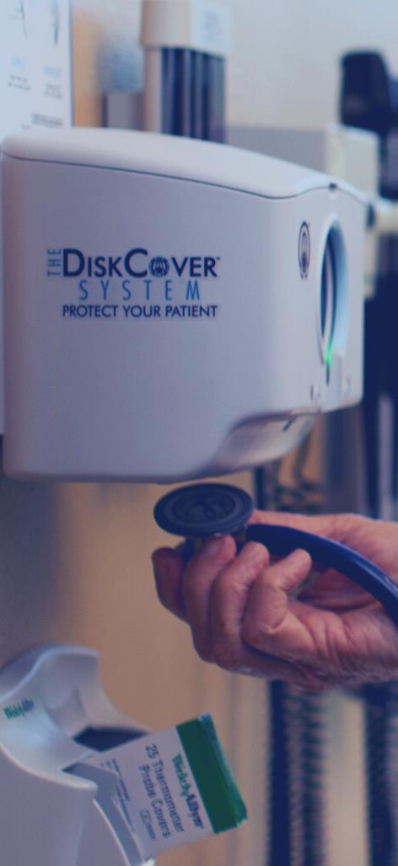
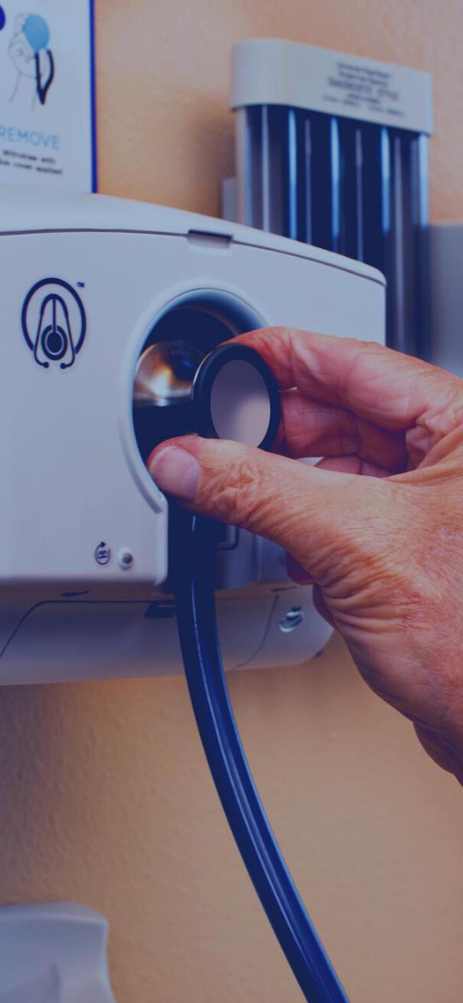
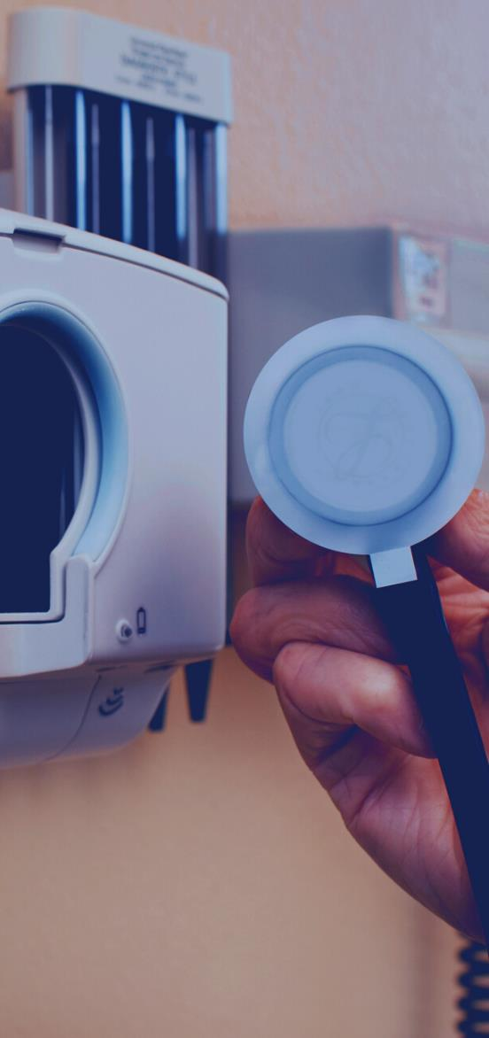
| WAVE, APPLY, REMOVE
1) ACTIVATE
2) APPLY
3) AUSCULTATE
HOLD STETHOSCOPE UNDER TOUCH-FREE SENSOR
PRESS GENTLY INTO APPLICATION WINDOW
EXAMINE PATIENT WITH CLEAN DISK COVER BARRIER

Slide 8

| 2024 CDC GUIDANCE
New CDC Guidance &
Stethoscope Hygiene Requirements
The Centers for Disease Control and Prevention (CDC) have updated their Guideline to Prevent Transmission of Pathogens in Healthcare Settings for 2024, including new requirements for stethoscope hygiene.

Slide 9

| 2024 CDC GUIDANCE
Stethoscopes Newly Categorized
As Transmission Via Touch
Stethoscopes are now confirmed to be contaminated and transmit pathogens efficiently between patients

Slide 10
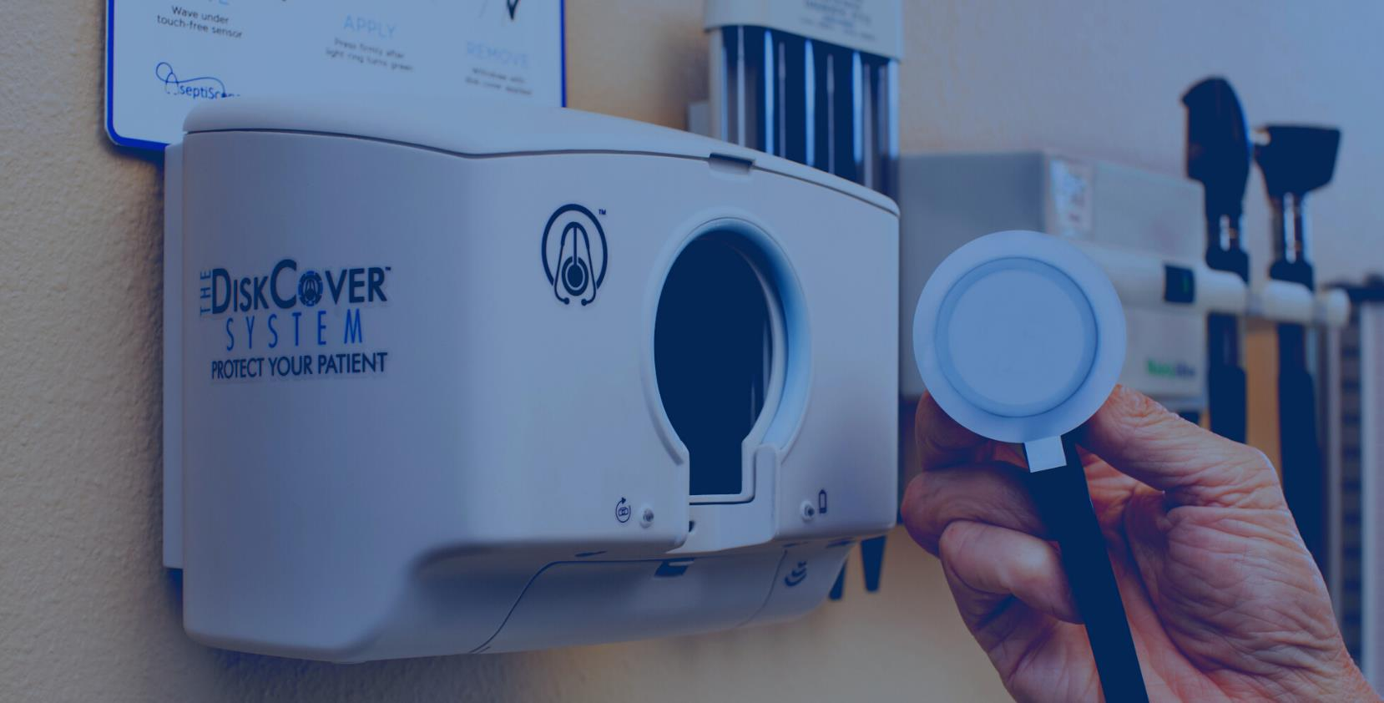
| 2024 CDC GUIDANCE
Stethoscope Hygiene Should Be Performed Between Patients
ONLY With The DiskCover System, Stethoscopes No Longer Touch Patients

Slide 11
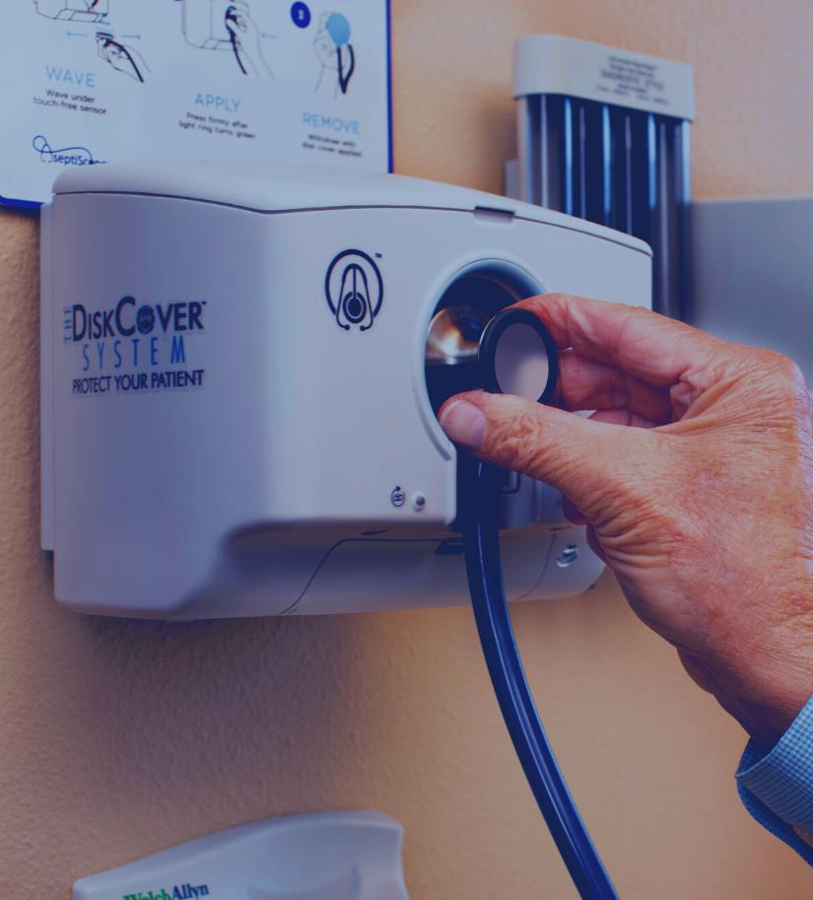
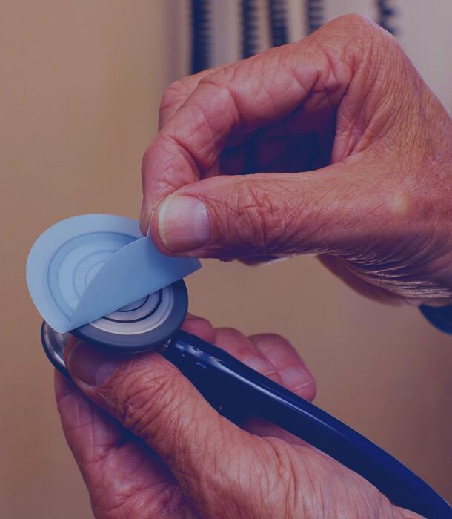
| 2024 CDC GUIDANCE
Recommendations Apply to
All Healthcare Facilities
Patient-care equipment is ideally dedicated to the patient and the patient’s designated space.
Disposable equipment may be used to minimize cross-transmission.

Slide 12
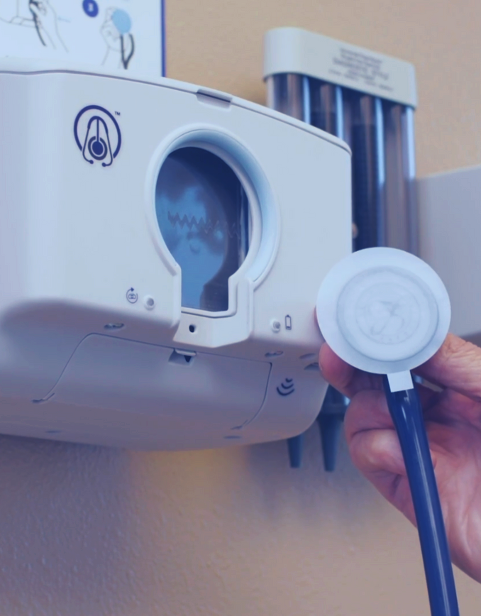
| FEATURES & BENEFITS
Stethoscopes Are Now Touch-Free
THE DISKCOVER SYSTEM
Features & Benefits
Stethoscopes never come in contact with patients when a disk cover barrier is applied,
eliminating pathogen transmission by touch.
Effective Stethoscope Diaphragm Barrier

Slide 13
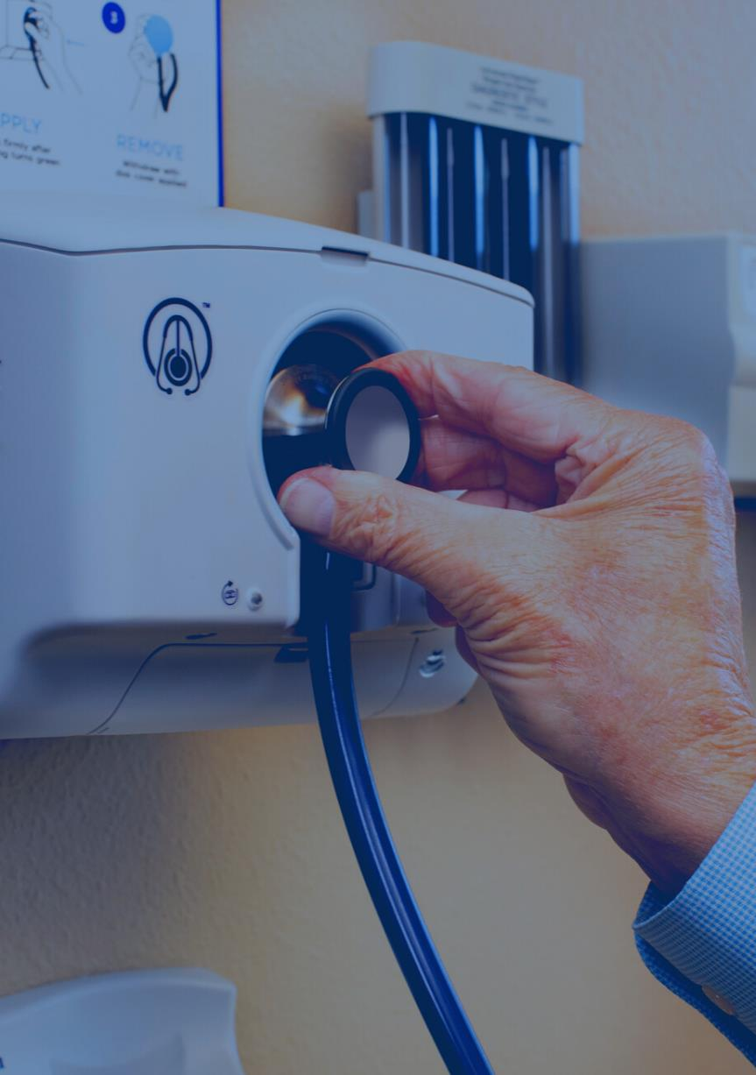
| FEATURES & BENEFITS
Touch-Free Barrier Application
THE DISKCOVER SYSTEM
Features & Benefits
Touch-Free, Automated Barrier Dispensing System
Ensures each patient examination is
clean and aseptic.
7

Slide 14

| FEATURES & BENEFITS
High Fidelity
THE DISKCOVER SYSTEM
Features & Benefits
Each disk cover is “acoustically invisible” for high quality auscultation, resulting in no loss in sound.
High Fidelity
5

Slide 15
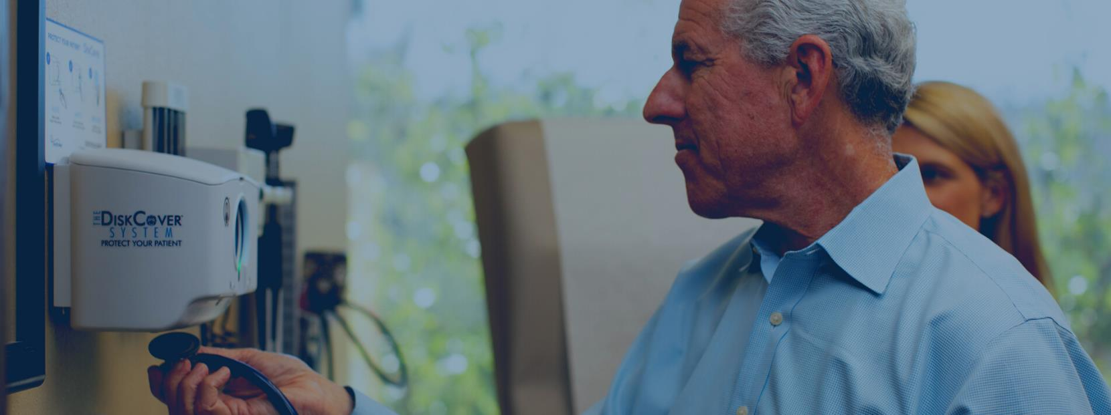
| FEATURES & BENEFITS
Immediate &
Workflow Compatible
THE DISKCOVER SYSTEM
Features & Benefits
Time-Saving, On-Demand Application
Disk covers are applied right at the point of care, making them compatible with clinical workflow.
8

Slide 16

| FEATURES & BENEFITS
Patient Protection & Optimal Safety
THE DISKCOVER SYSTEM
Features & Benefits
Patient
Protection
Each disk cover protects patients from pathogen exposure.
3, 7

Slide 17


| FEATURES & BENEFITS
Patient Satisfaction
Visual Indicator
of Elevated Patient Protection
THE DISKCOVER SYSTEM
Features & Benefits
Disk covers are visible to patients and help boost patient satisfaction.

Slide 18
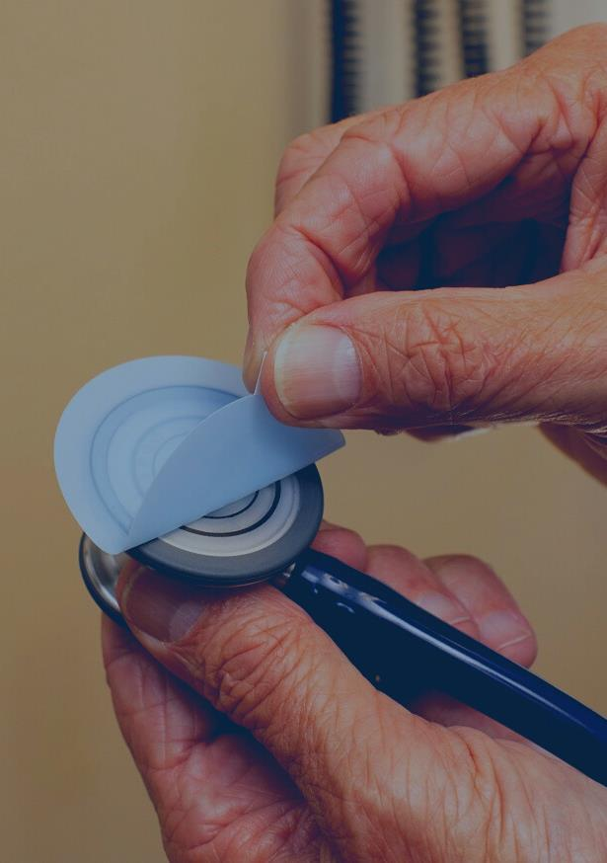
| FEATURES & BENEFITS
Sustainability
Minimized
Waste
THE DISKCOVER SYSTEM
Features & Benefits
Each disk cover uses
<0.5% of disposable material of a single-patient stethoscope.

Slide 19
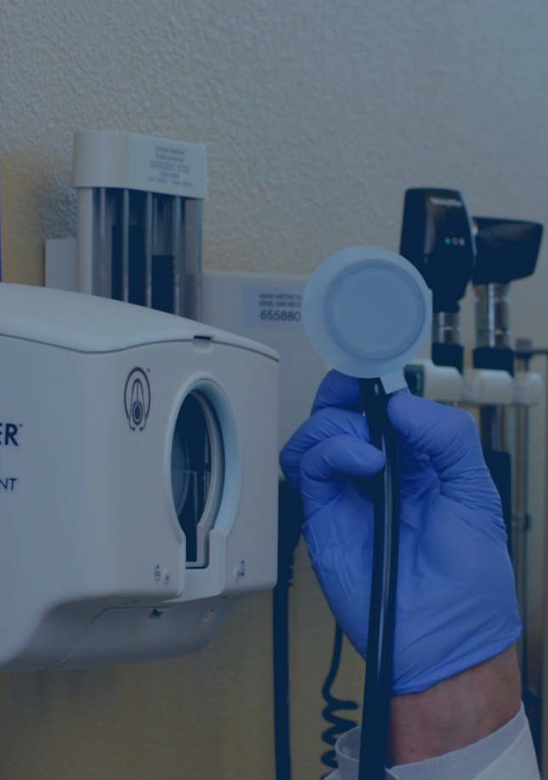
| FEATURES & BENEFITS
Antimicrobial Stewardship
Antimicrobial-Free & Effective Against Resistant Pathogens
THE DISKCOVER SYSTEM
Features & Benefits
Disk covers do not contribute to antimicrobial resistance of pathogens.
3

Slide 20
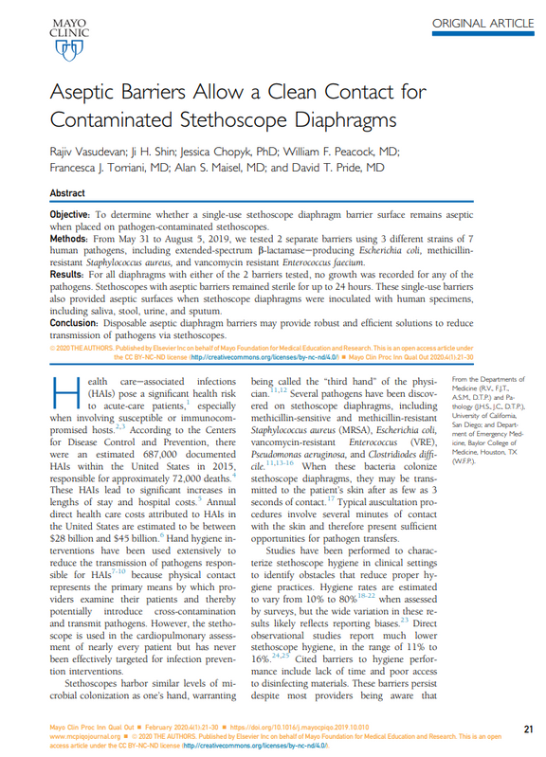
| CLINICAL DATA
Aseptic Barriers Allow a Clean Contact for Contaminated Stethoscope Diaphragms
Rajiv Vasudevan; Ji H. Shin; Jessica Chopyk, PhD; William F. Peacock, MD; Francesca J. Torriani, MD; Alan S. Maisel, MD; and David T. Pride, MD
Mayo Clinic Proceedings: Innovations, Quality & Outcomes
Key Points:
Diaphragms protected by a disk cover were 100% culture negative.
Disk covers may reduce transmission of pathogens via stethoscope.
7
7

Slide 21
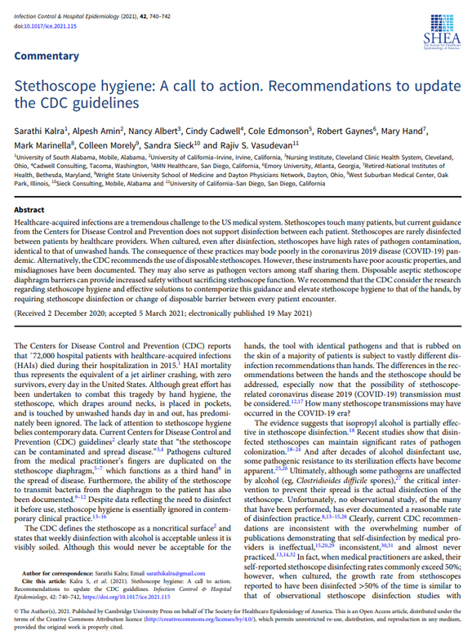
| CLINICAL DATA
Stethoscope hygiene: A call to action. Recommendations to update the CDC guidelines
Sarathi Kalra; Alpesh Amin; Nancy Albert; Cindy Cadwell; Cole Edmonson; Robert Gaynes; Mary Hand; Mark Marinella; Colleen Morely; Sandra Sieck; and Rajiv S. Vasudevan
Infection Control & Hospital Epidemiology
Key Points:
Mounting research and evidence supports the need for elevated stethoscope hygiene.
Just like hand hygiene, stethoscope hygiene should be required between every patient encounter.
9
9

Slide 22
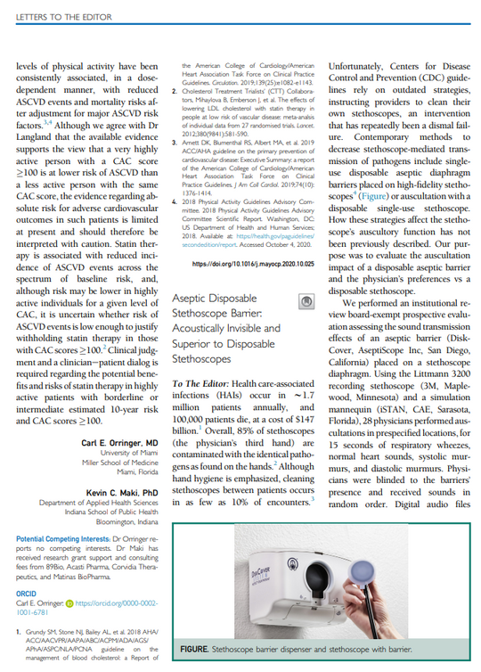
| CLINICAL DATA
Aseptic Disposable Stethoscope Barrier: Acoustically Invisible and Superior to Disposable Stethoscopes
Sarathi Kalra; Jitesh B. Shewale
Mayo Clinic Proceedings
Key Points:
Aseptic barriers are acoustically invisible and do not alter high-fidelity auscultation.
Aseptic barriers are superior to disposable stethoscopes in both sound quality and cost.
5
5

Slide 23
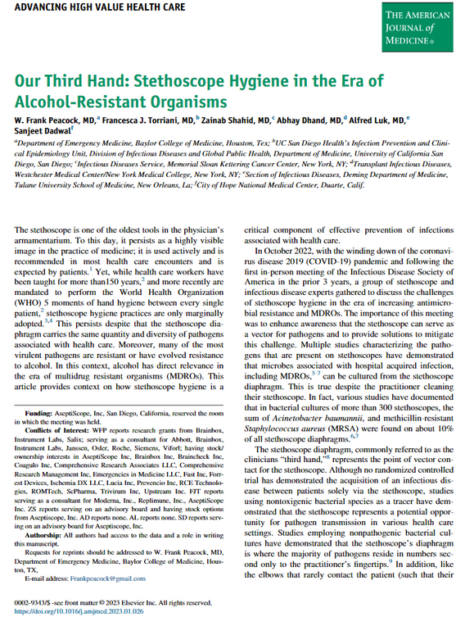
| CLINICAL DATA
Our Third Hand: Stethoscope Hygiene in the Era of Alcohol-Resistant Organisms
W. Frank Peacock, MD; Francesca J. Torriani, MD; Zainab Shahid, MD; Abhay Dhand, MD; Alfred Luk, MD; Sanjeet Dadwal
The American Journal of Medicine
Key Points:
Overreliance of cleaning agents contributes to resistant pathogens.
Stethoscope cleaning compliance is low.
These factors support the use of disposable barriers for stethoscope hygiene.
3
3
3

Slide 24
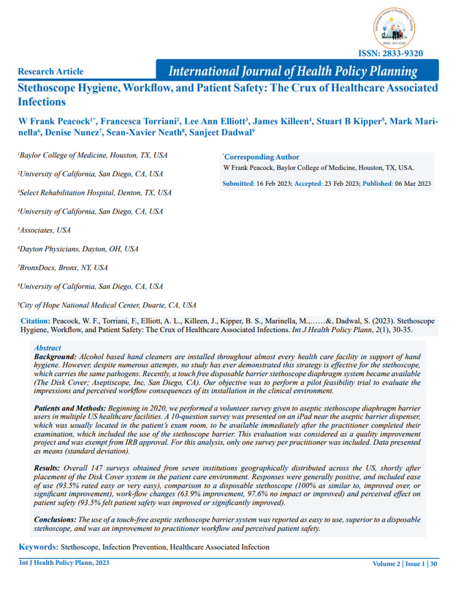
| CLINICAL DATA
Stethoscope Hygiene, Workflow, and Patient Safety: The Crux of Healthcare Associated Infections
W. Frank Peacock; Francesca Torriani; Lee Ann Elliott; James Killeen; Stuart B Kipper; Mark Marinella; Denise Nunez; Sean-Xavier Neath; Sanjeet Dadwal
International Journal of Health Policy Planning
Key Points:
The DiskCover System was reported as:
Easy to Use
Superior to Disposables
Improvement to Clinician Workflow & Patient Safety
8
8
8

Slide 25
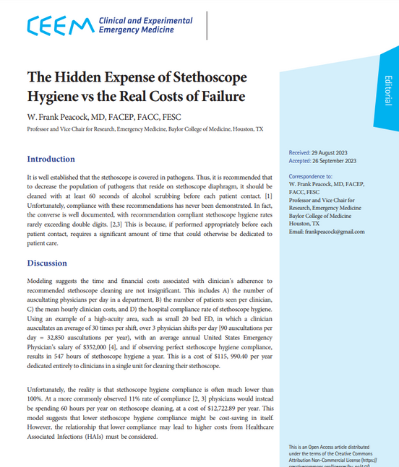
| CLINICAL DATA
The Hidden Expense of Stethoscope Hygiene vs The Real Costs of Failure
W. Frank Peacock, MD
Clinical and Experimental Emergency Medicine
Key Points:
Clinician time, potential HAIs, and disposable stethoscope costs reveal extensive expenses of stethoscope hygiene failure.
Adoption of dispensers of touch free stethoscope barriers offset these costs to provide a positive return on investment.
10
10
ROI & Value Analysis Data available upon request.

Slide 26



| SUMMARY
Only The DiskCover System Can Fulfill All Key Attributes
1
Stethoscope Hygiene Attribute | Isopropyl Alcohol Wipes | Single-Use Stethoscopes
Prevents Contamination Between Patients
Always Provides Aseptic Patient Contact
Fully Effective Against Pathogens (Including MDROs)
Mitigates Transmission Between Clinicians
Rapid To Use (<2 Seconds)
Does Not Impair Auscultation Quality
Cost-Effective
Data Capture (Usage & Supply)
Does Not Degrade Stethoscope
1
Table 2 (Adapted)

Slide 27
| REFERENCES
References
Peacock, W. Frank, et al. “A new normal for the clinician’s third hand: Stethoscope Hygiene and infection prevention.” American Journal of Infection Control, vol. 51, no. 1, Jan. 2023, pp. 114–118.
Longtin, Yves, et al. “Contamination of stethoscopes and physicians’ hands after a physical examination.” Mayo Clinic Proceedings, vol. 89, no. 3, Mar. 2014, pp. 291–299.
Frank Peacock, W., et al. “Our third hand: Stethoscope hygiene in the era of alcohol-resistant organisms.” The American Journal of Medicine, vol. 136, no. 6, June 2023, pp. 551–554.
Jenkins, Ian Harold, et al. “The third hand: Low rates of stethoscope hygiene on General Medical Services.” Journal of Hospital Medicine, vol. 10, no. 7, 2 Apr. 2015, pp. 457–458.
Kalra, Sarathi, et al. “Aseptic Disposable Stethoscope Barrier: Acoustically Invisible and Superior to Disposable Stethoscopes.” Mayo Clinic Proceedings, vol. 96, no. 1, Jan. 2021, pp. 263–264, https://doi.org/10.1016/j.mayocp.2020.10.029.
Knecht, Vincent R., et al. “Molecular analysis of bacterial contamination on stethoscopes in an intensive care unit.” Infection Control & Hospital Epidemiology, vol. 40, no. 2, 12 Dec. 2018, pp. 171–177.
Vasudevan, Rajiv, et al. “Aseptic barriers allow a clean contact for contaminated stethoscope diaphragms.” Mayo Clinic Proceedings: Innovations, Quality & Outcomes, vol. 4, no. 1, Feb. 2020, pp. 21–30.
Peacock, W. Frank, et al. “Stethoscope hygiene, workflow, and Patient Safety: The crux of healthcare associated infections.” International Journal of Health Policy Planning, vol. 2, no. 1, 6 Mar. 2023.
Kalra, Sarathi, Alpesh Amin, et al. “Stethoscope hygiene: A call to action. recommendations to update the CDC guidelines.” Infection Control & Hospital Epidemiology, vol. 42, no. 6, 19 May 2021, pp. 740–742.
Peacock, W. Frank. “The Hidden Expense of Stethoscope Hygiene vs The Real Costs of Failure.” Clinical and Experimental Emergency Medicine. 11 Jan. 2024, https://doi.org/10.15441/ceem.23.161.

Slide 28
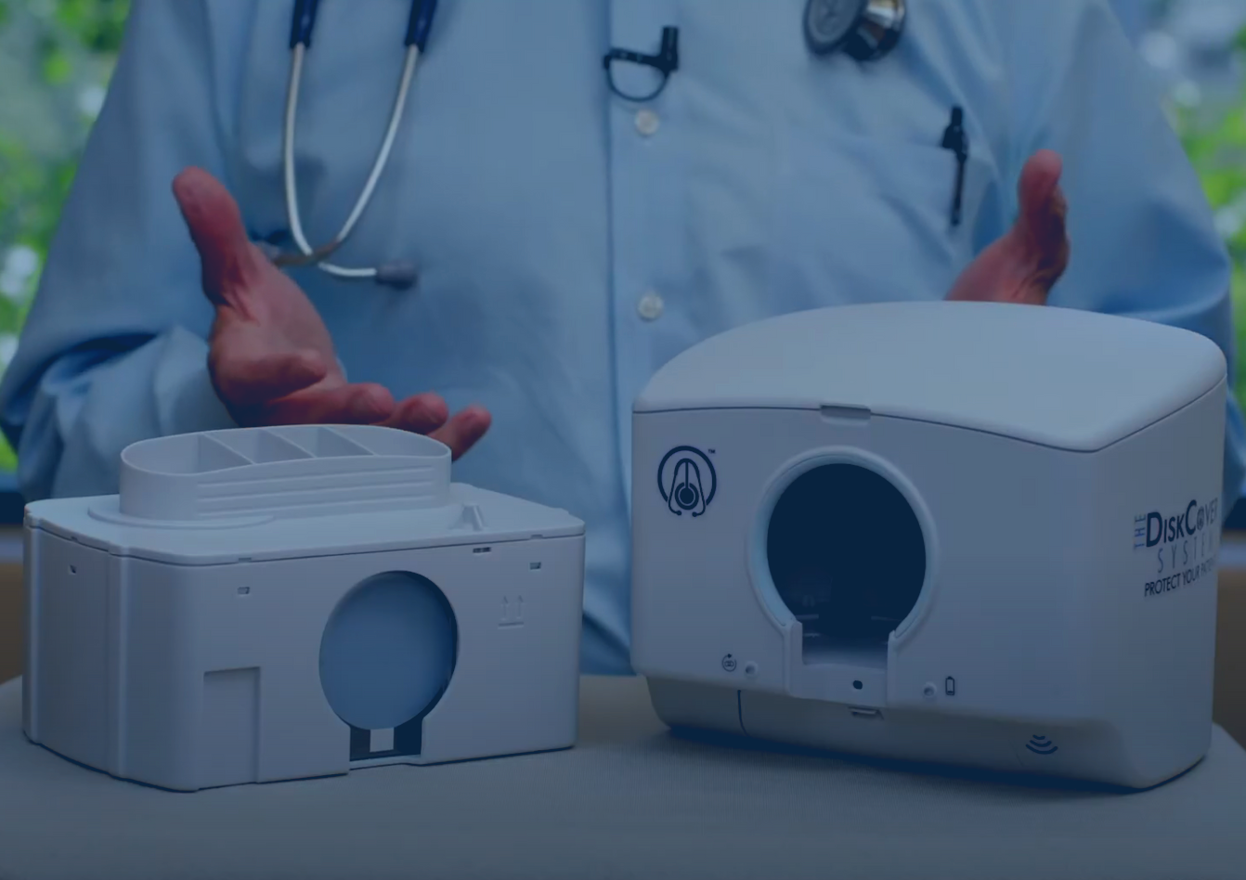


| ASEPTISCOPE, INC.
GET STARTED
Quote | Purchase
© 2019 ASEPTISCOPE, INC. ALL RIGHTS RESERVED. ASEPTISCOPE, DISKCOVER, AND RELATED LOGOS ARE REGISTERED TRADEMARKS OF ASEPTISCOPE, INC. LBL-1075-00

